Slide 1
ANALYSIS OF Employee​ ​Satisfaction
ADVAIT KULKARNI SUHIT DATTA
VARAD TUPE

Slide 2


Objective
What drives an employee to make career decisions.
What factors contribute to employee satisfaction and his/her decision to leave the company.
To analyze why some experienced employees leave prematurely from a company.
Building an optimal model to predict employee satisfaction and decision.

Slide 3
Data Description
Field Name | Description
satisfaction_level | Level of satisfaction (0-1)
last_evaluation | Time since last performance evaluation (in Years)
number_project | Number of projects completed while at work
average_montly_hours | Average monthly hours at workplace
time_spend_company | Number of years spent in the company
Work_accident | Whether the employee had a workplace accident
left | Whether the employee left the workplace or not (1 or 0) Factor
promotion_last_5years | Whether the employee was promoted in the last five years
sales | Department in which they work for
salary | Relative level of salary (high, medium, low)

Slide 4
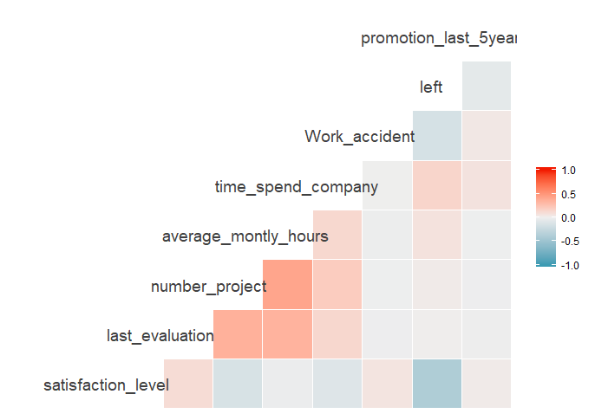
Correlation Plots

Slide 5
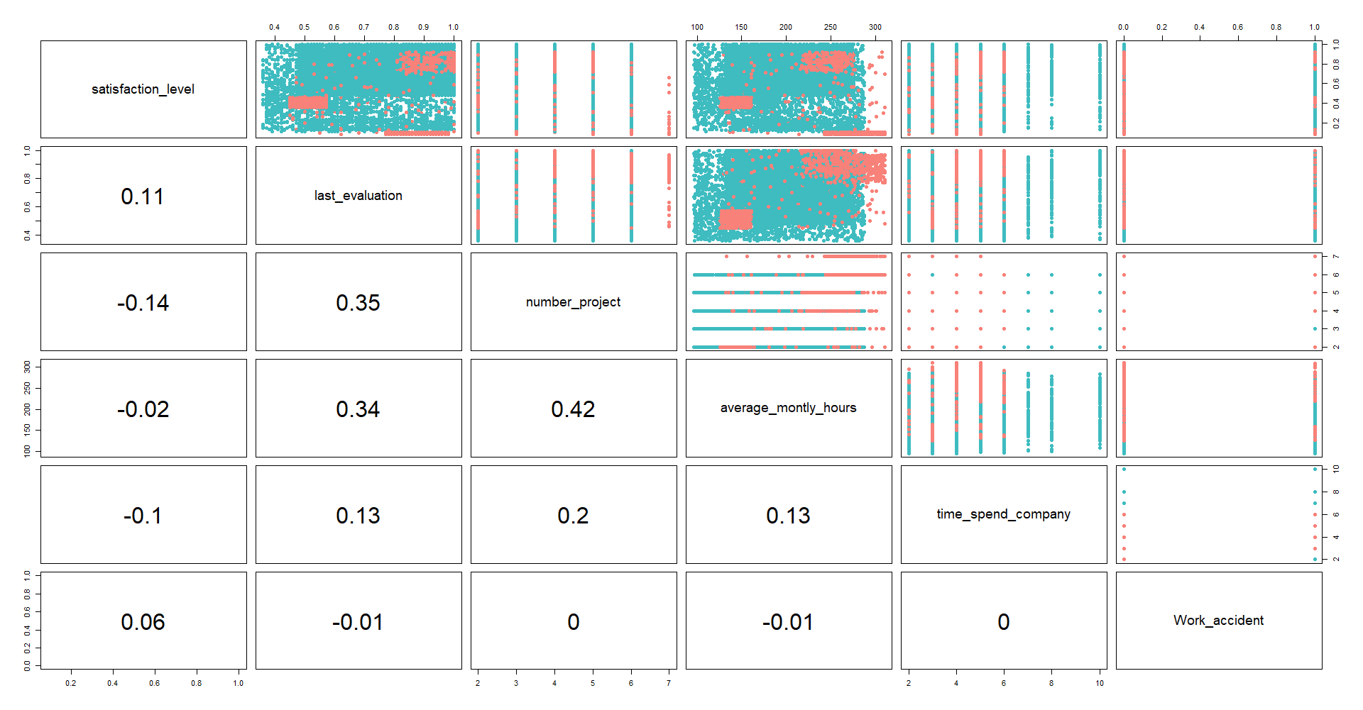

Slide 6
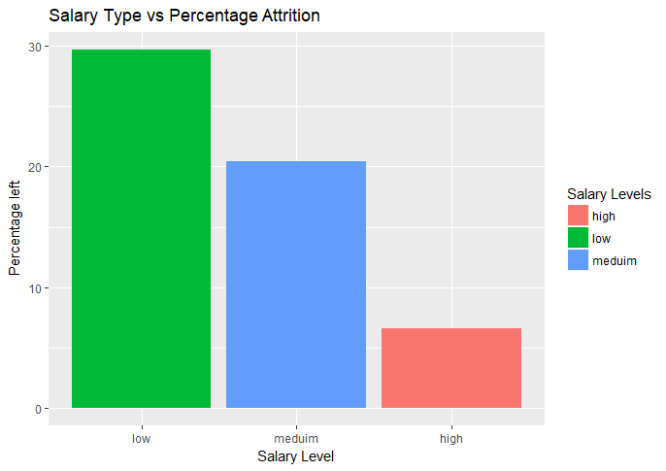
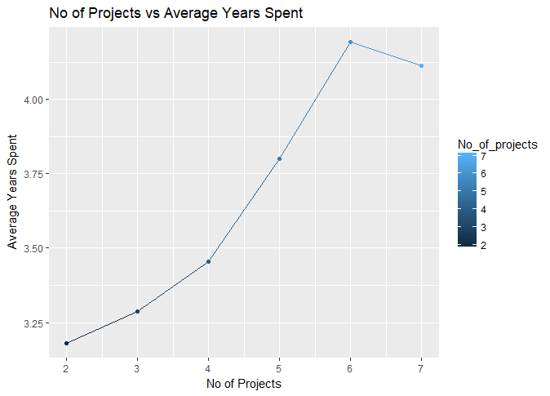
Relationship between No of Projects and the Average Years spent in the Company
Distribution of the Salary Category vs Attrition Percent

Slide 7
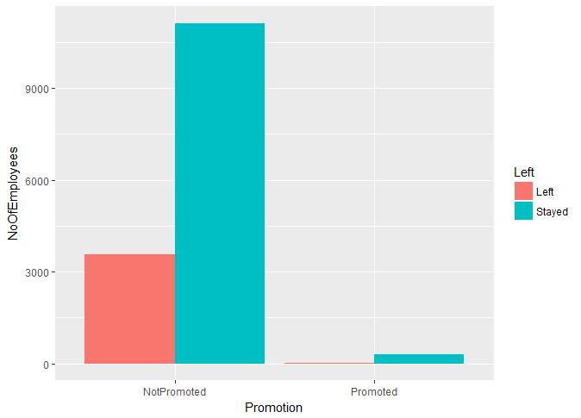
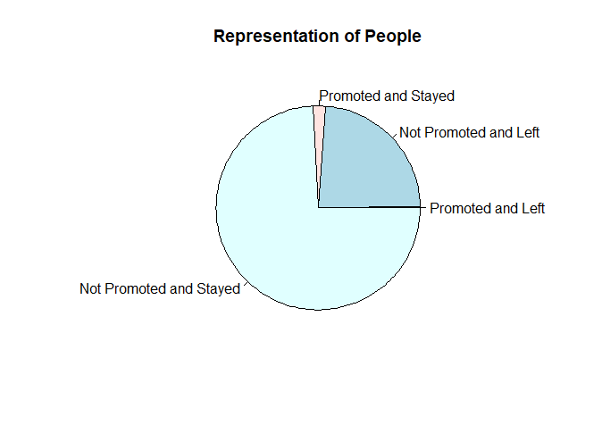
By Promotion in the last 5 years
Almost ¼ th of the people left !

Slide 8
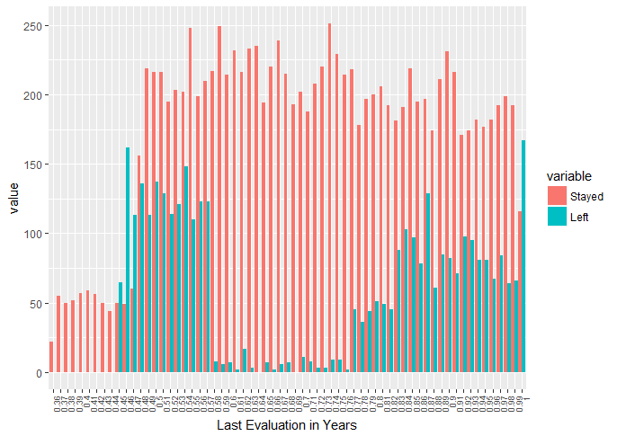
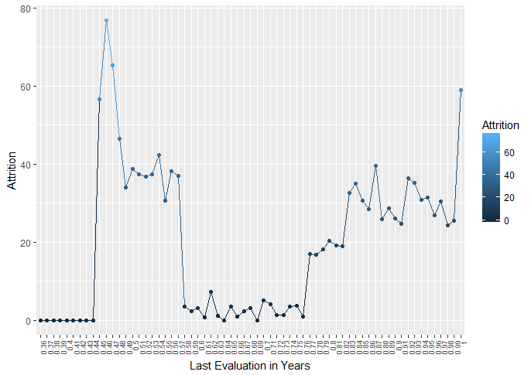
By Last Evaluation

Slide 9
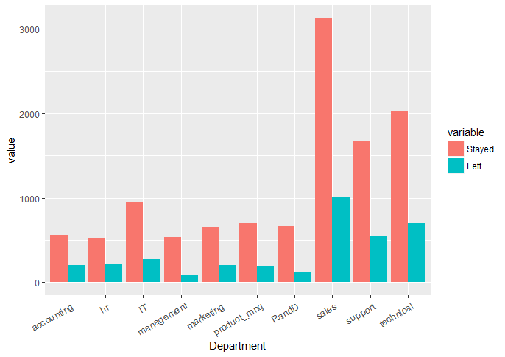
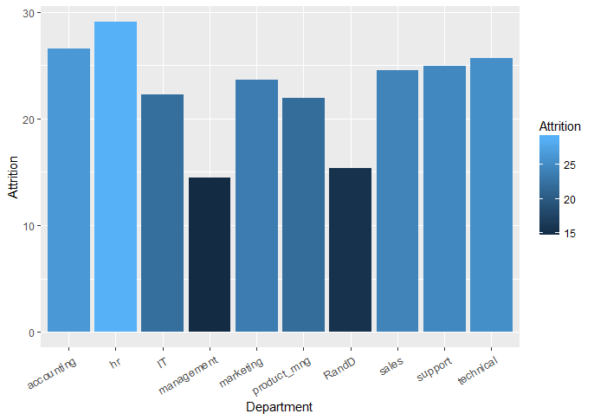
By Department

Slide 10
By Satisfaction Level
Satisfaction Level | Qualitative Equivalent
Greater than 0.8 | Very High
Between 0.6 and 0.8 | High
Between 0.4 and 0.6 | Medium
Between 0.2 and 0.4 | Low
Less than 0.2 | Very Low

Slide 11
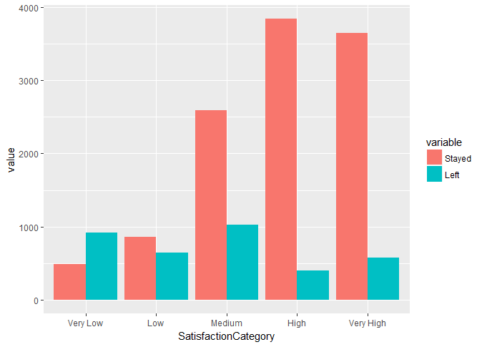
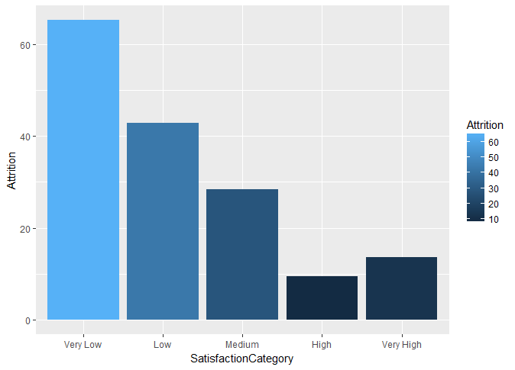

Slide 12
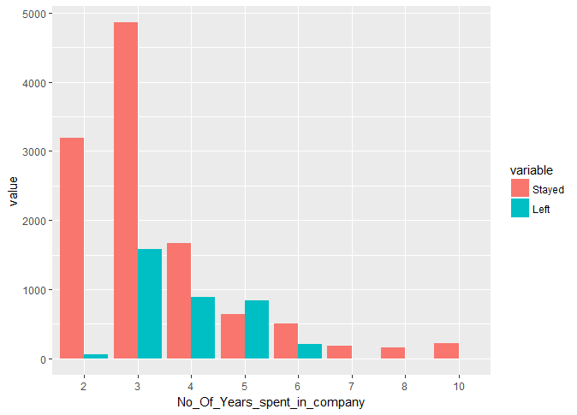
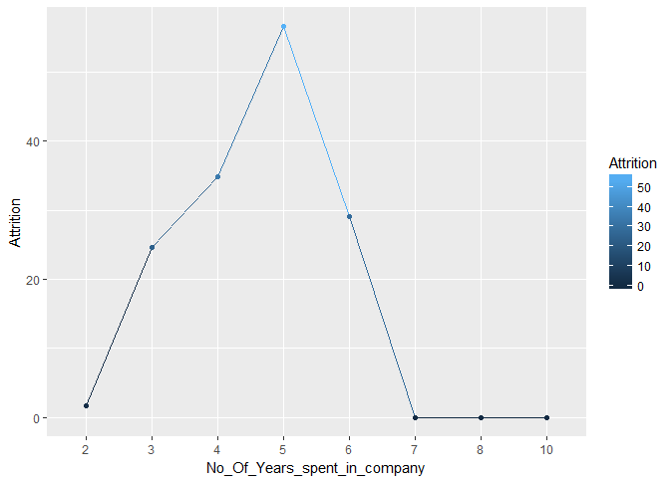
By Number of Years spent in the Company

Slide 13
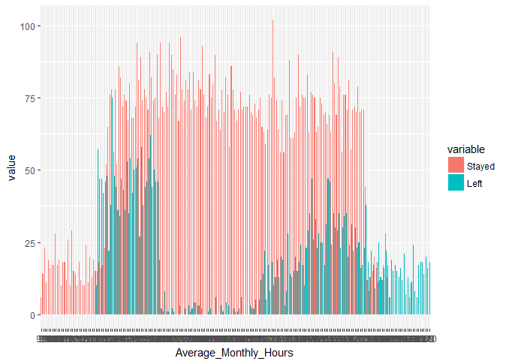
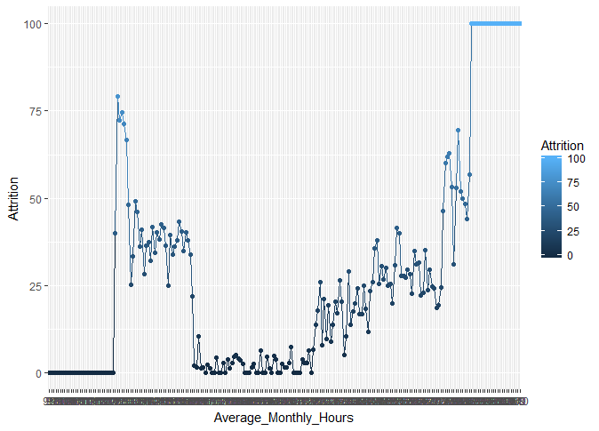
By Average monthly hours spent at Workplace

Slide 14
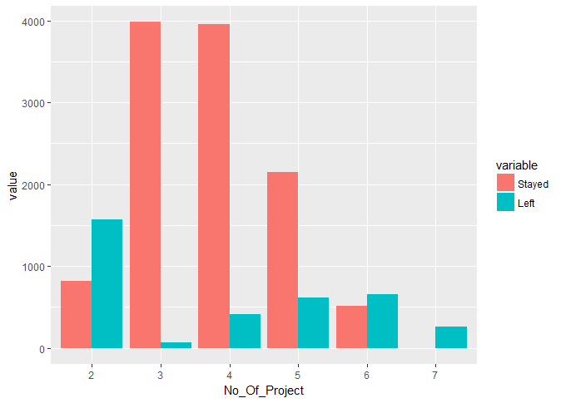
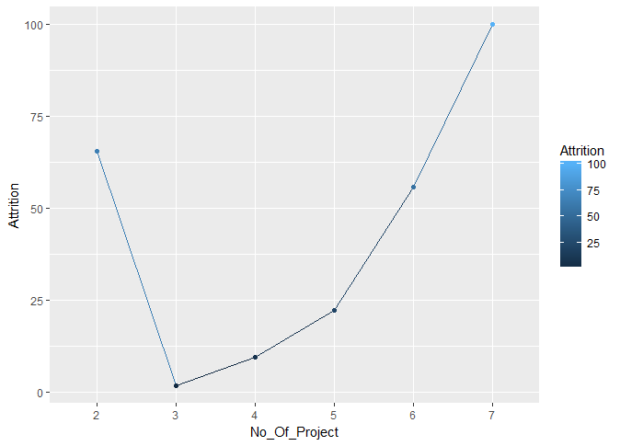
By Number of Projects

